Slide 1
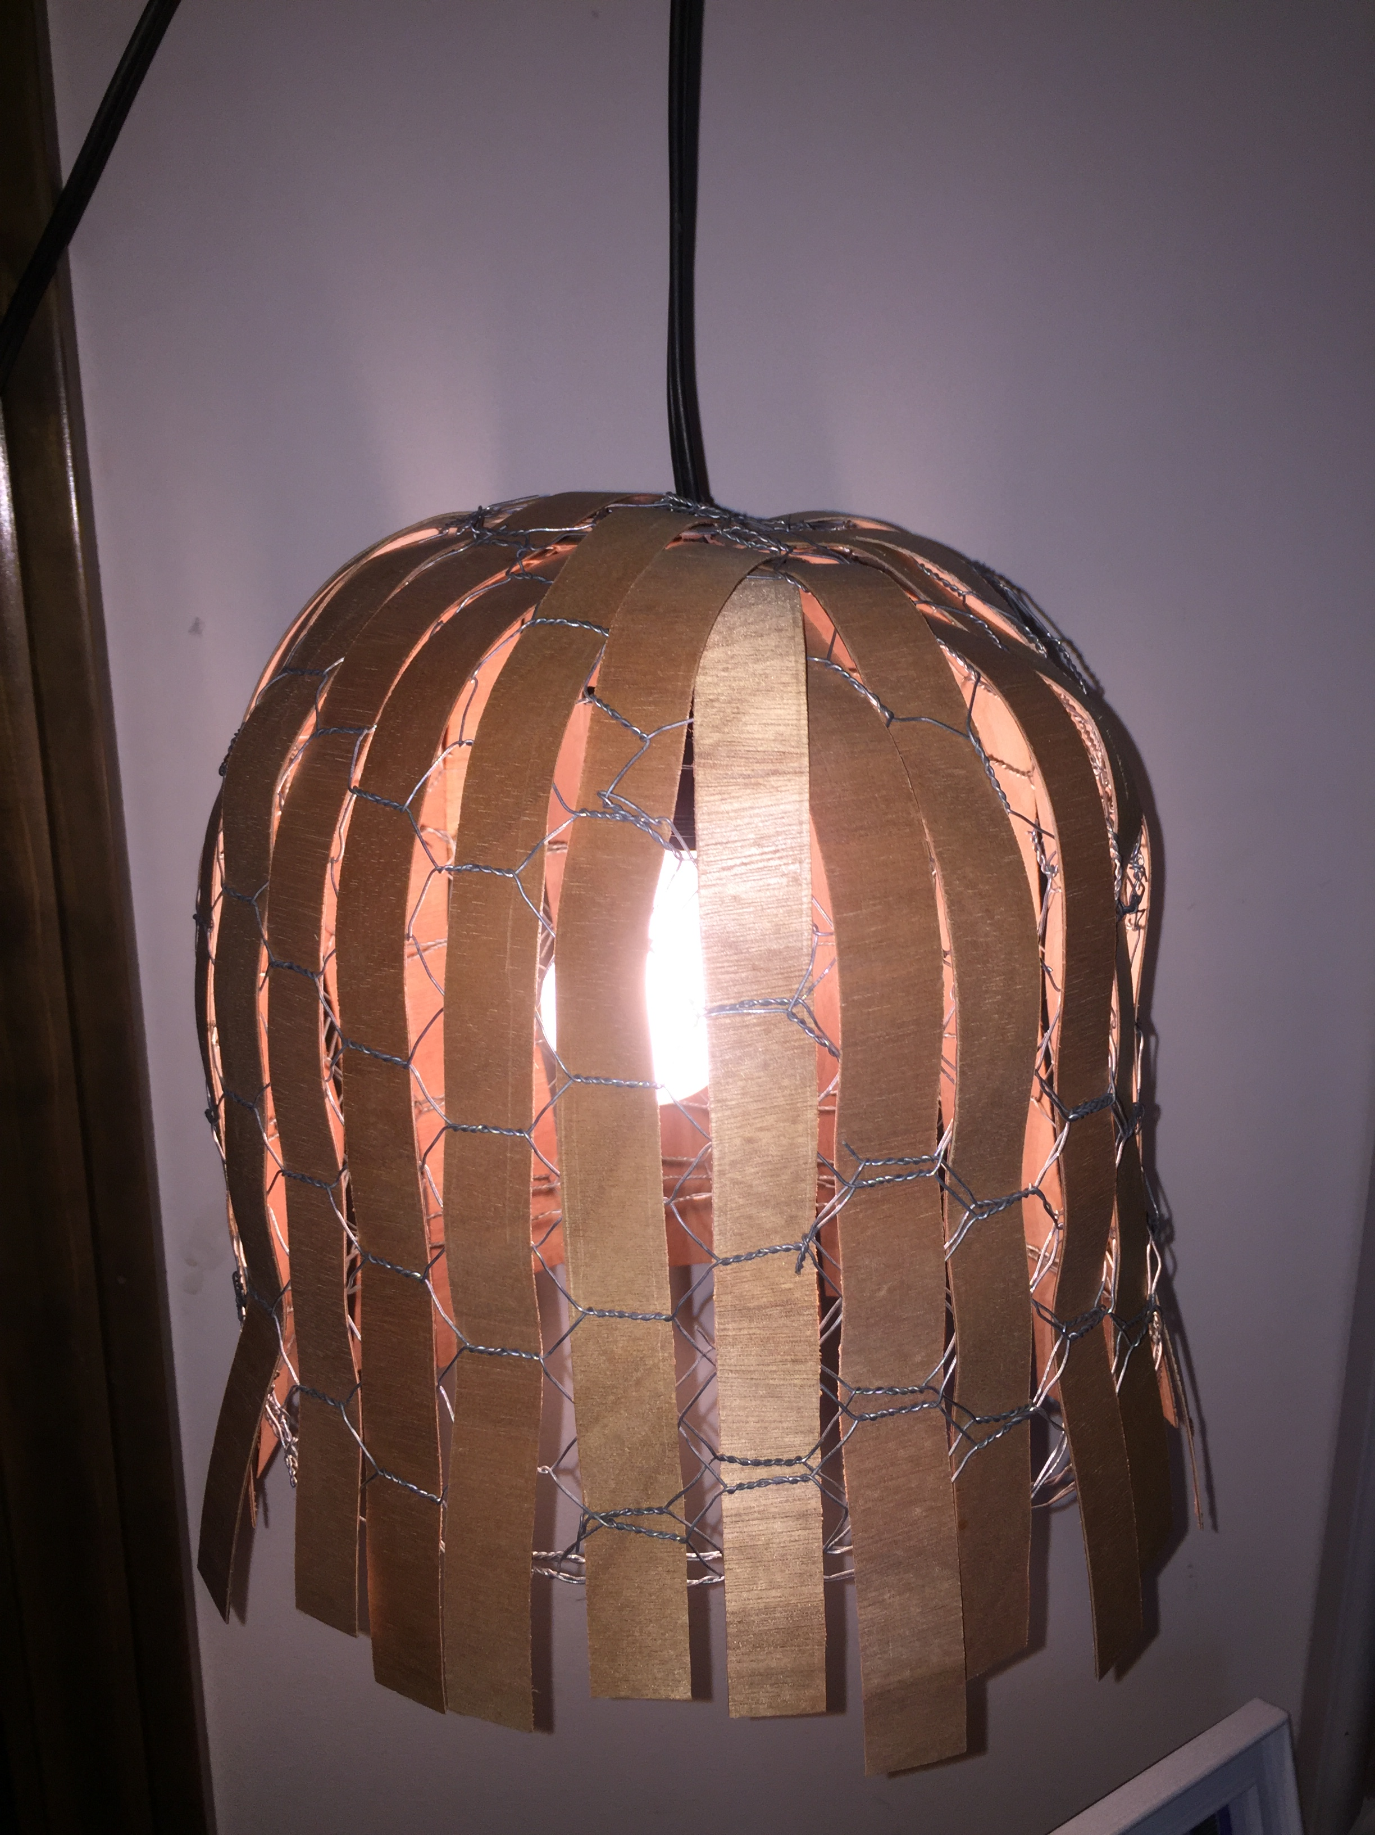
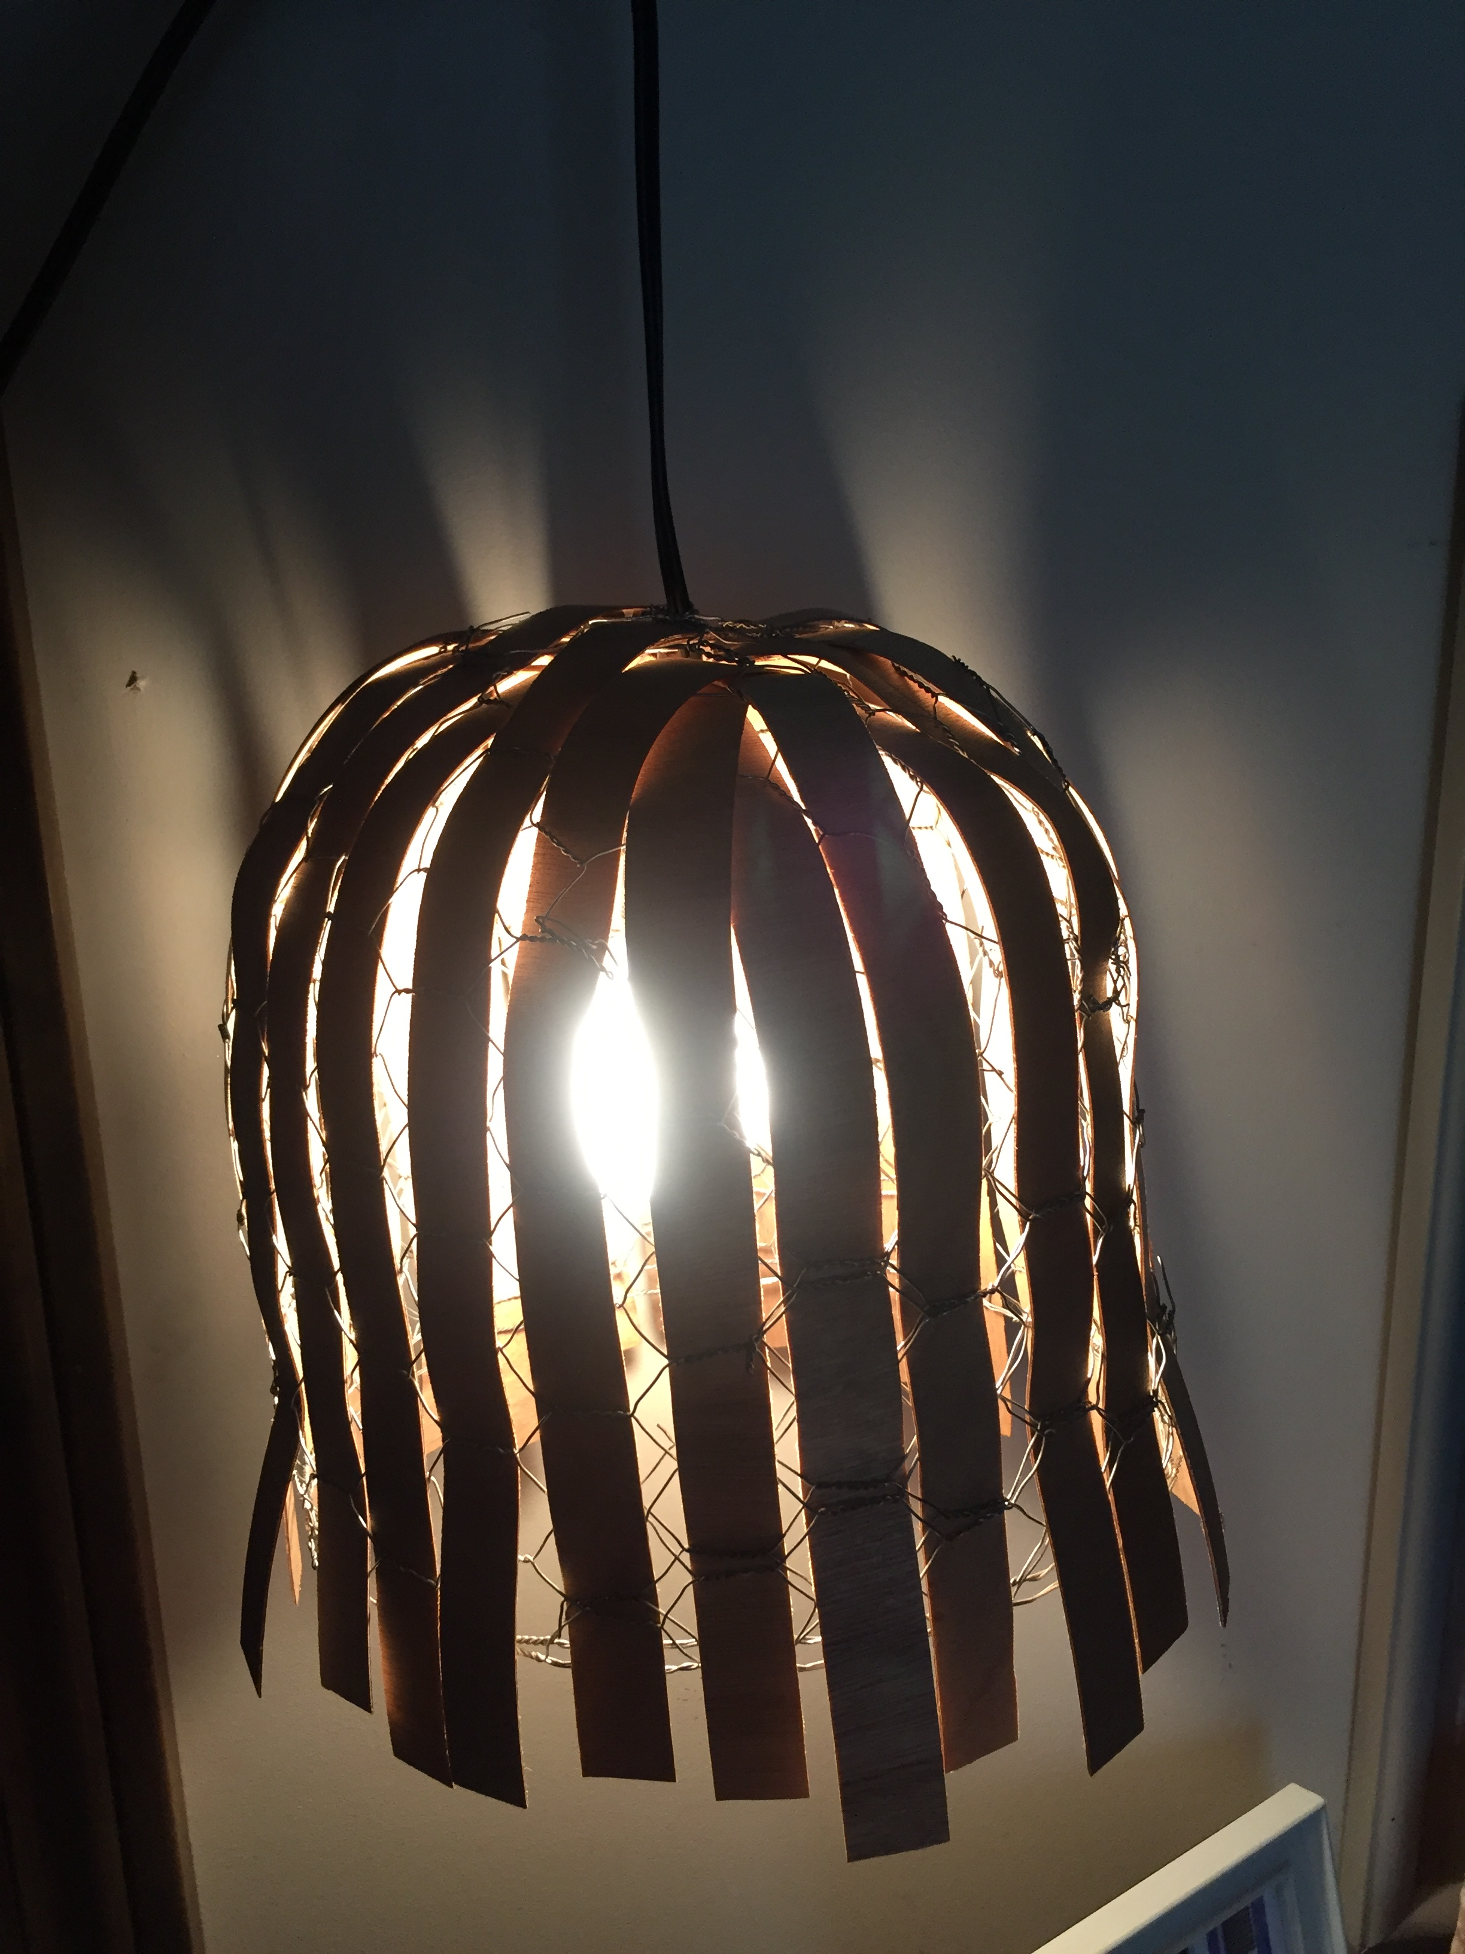
“wired”
BY: JESSIE WHITMORE
‘Green Design’ is a style to building that minimizes harmful effects on human health and the environment. Also known as ‘sustainable design’, it aims at incorporating environmental features without compromising performance, quality, functionality, and the useful life of the item. With this project we were told to use materials that are sustainable, which is an important aspect to learn as we approach the professional world.
The inspiration for my light fixture came from wanting a more rustic/industrial design, and the urge to use anything recycled. We had some chicken wire in our garage, and my dad had veneer sheeting in the library of his office that I cut into thin strips. I formed the chicken wire into the shape of a lampshade, and weaved the strips of veneer throughout.
The vertical lines used in the light fixture create rhythm, and a downward flow. The space between the strips of veneer allow the light to openly shine through, and being able to see the wire underneath adds contrast and variety of materials in the design. The color palette helps with a rustic/industrial feel. The process of forming the wire took the most time to accomplish. I had to cut, and form the wire to fit on top of each opening, to make it easy to weave the veneer through.
This pendant would be ideally suited in an entryway, or above a table or island. It is a statement piece that would easily be emphasized in a simpler, non-cluttered space, and used as an accent piece.
Once the light fixture is ready to be thrown away, everything used is able to be recycled or reused. The chicken wire can be bent back into its original flat form, and be used as its original fencing purpose. If you’re a crafty person, you can use the veneer strips in different home DIY projects, or choose to recycle either.

